Slide 1
IMDB MOVIE RECOMMENDER SYSTEM
Ben Rosensweig, Ethan Tebbe, Hassan Aftab, Jorge Arroyo

Slide 2
Project Purpose & Inspiration
Purpose: Our project aims to create a movie recommendation system using the IMDB Movies Dataset. Users will receive personalized movie suggestions based on inputted preferences, leveraging data such as genre, director, and ratings. This project combines data analysis, machine learning, and web development to deliver a practical and engaging tool for movie enthusiasts.
Inspiration: We were inspired by Kaggle projects that used the IMDB dataset for genre classification and movie recommendation systems, as well as creative visualizations on Tableau that analyzed movie trends. These resources guided our approach and development.

Slide 3
Design Concepts
Chosen Palette: IMDB Color Palette
Yellow, black, and white—consistent with the IMDB brand.
Resources:
User-created IMDB color palette: Color Palette
Official IMDB brand documentation: IMDB Brand Guidelines

Slide 4
Research Questions?
Key Questions We Are Investigating:
Is there a relationship between movie rating and gross income?
Do certain directors tend to produce higher-rated movies?
Are movie ratings trending upward or downward over the years?
Are certain genres becoming more popular over time?
Visualizations Planned:
Bar Charts: Genre and Release Year
Bubble Charts: IMDB Rating and Genre
Scatter Plot: Film Profits vs Number of Ratings

Slide 5
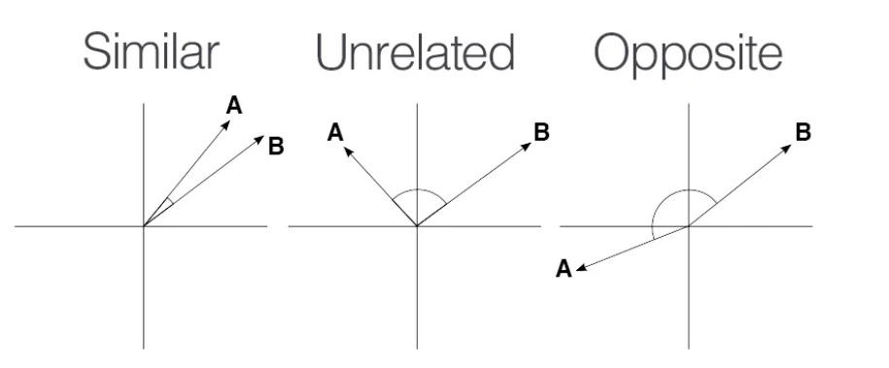
Our Recommendation System
We used NLTK to process the overview of the movie.
We used Term Frequency-Inverse Document Frequency to generate vectors for each movie.
With those vectors, we generated a matrix of similarities using cosine similarity.
From the matrix of similarities, we are able to generate a list of recommendations via sorting the list.

Slide 6
Live Demo
https://ethanmtebbe.pythonanywhere.com/

Slide 7
We built a functional, user-friendly movie recommendation system.
Our project combines data analysis, machine learning, and front-end development.
The final product uses the IMDB and TMDB datasets to give relevant recommendations based on user input.
Conclusion

Slide 8
Final Notes
Future Work: For future improvements, we plan to:
Incorporate a more updated and comprehensive movie dataset to broaden the recommendations.
Enhance the recommendation algorithm by factoring in user reviews and viewing history for better personalization.
Introduce real-time movie data and integrate streaming service availability to offer more relevant, up-to-date suggestions.

Slide 9
Work Cited
DataSet: https://www.kaggle.com/datasets/harshitshankhdhar/imdb-dataset-of-top-1000-movies-and-tv-shows/data
Slide Deck Template: https://slidesgo.com/theme/movie-awards-ceremony#search-movie&position-4&results-232&rs=search
Color Palette: https://www.color-hex.com/color-palette/4236
Websites:

Slide 10
Q & A?

Slide 11
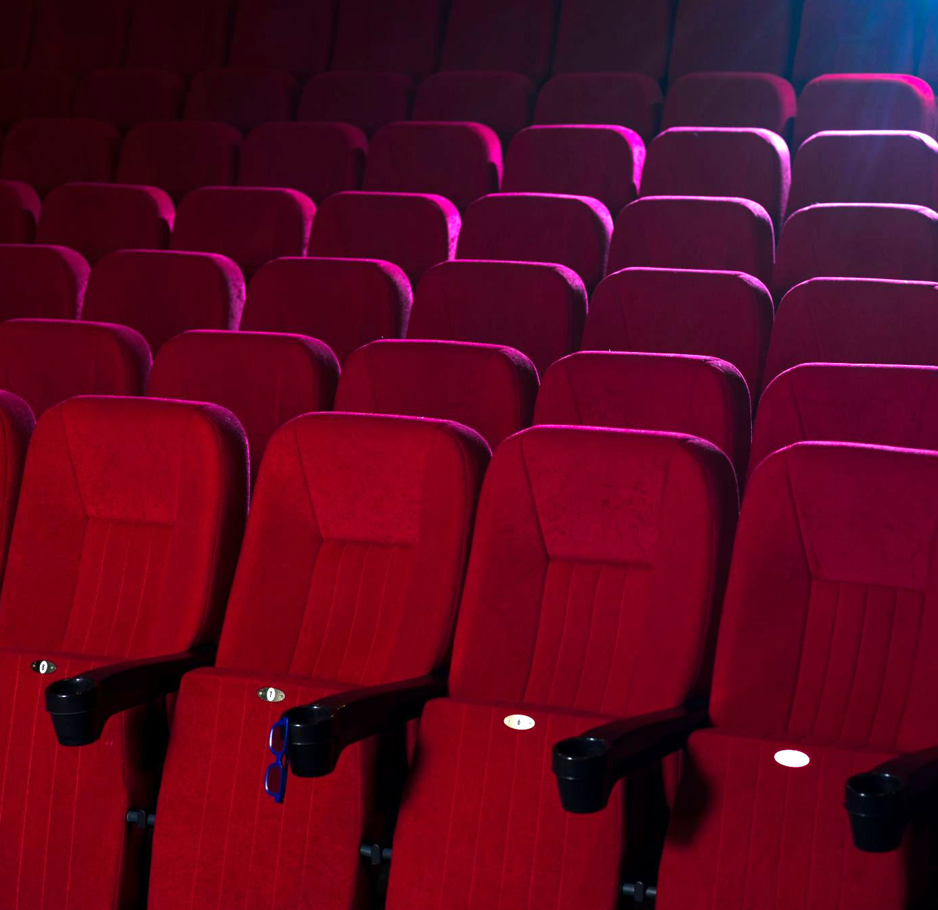




The Team
Ethan Tebbe
Hassan Khan
Jorge Arroyo
Ben Rosensweig

Slide 12
The End

